Slide 1
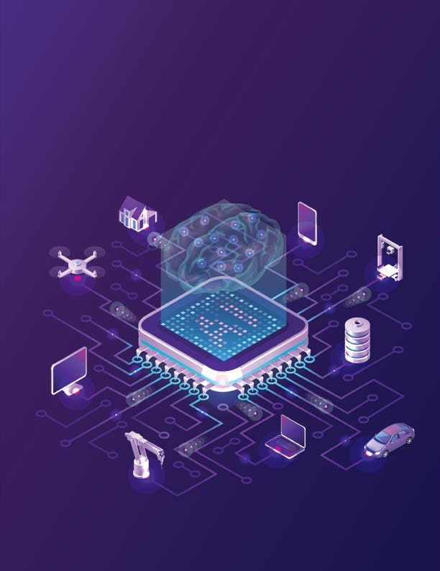

YARDI SCHOOL OF ARTIFICIAL INTELLIGENCE
(Yardi ScAI)
Indian Institute of Technology Delhi

Slide 2

About Yardi ScAI
Yardi School of Artificial Intelligence (Yardi ScAI) has been established in September 2020 to strengthen education and research in artificial intelligence (AI), machine learning (ML), data science (DS) and their broad applications such as in healthcare, materials science, robotics, industry 4.0, weather prediction, and transportation.
The focus on applications makes the school multidisciplinary – it currently has support from 48 faculty members from 13 departments. These include departments that typically hire core AI, ML and DS researchers such as computer science, electrical engineering, and mathematics. It also includes researchers specializing in the use of AI for various domains, for example, from biomedical engineering, atmospheric sciences, management sciences, and civil engineering. This eclectic group of researchers creates novel opportunities for collaboration; indeed, several new projects have recently been undertaken by groups that comprise AI experts and domain experts. In the long run, ScAI aims to make significant impact to the betterment of environment, society and industry.
Yardi ScAI has already started several educational programmes, including PhD, Master of Science (Research) and Master of Technology. An outreach
training programme in AI and ML is also being run under its aegis. In the future, it envisions online degree programmes to train students at large in these important technical areas.
ScAI faculty have strong partnerships with top industries through collaborative research and consultancy projects. They also advise several startups in the country and abroad. They also regularly feature in high-level government committees deliberating on AI policies and deployment.
Yardi ScAI was initially supported by seed funding from Google and Mr. Arun Duggal, and, subsequently, a US$ 10 million funding from Mr. Anant Yardi, the CEO of Yardi Systems. This funding enables ScAI to undertake various schemes to kickstart a strong academic unit. These include travel grants to students and faculty for presenting papers at top conferences, open access fees for publishing papers at reputed journals, fellowships to deserving students, and in-house research grants to encourage groups of researchers to undertake grand challenge AI problems. ScAI is also currently building a large AI-specific supercomputing facility, thanks to a Rs. 120 crores grant by National Supercomputing Mission, Government of India.

Slide 3
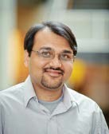

Message from the Head
Less than 2% of world’s AI PhDs are from India!
With over one-sixth of the world’s population in India, it is heartening that India is ranked high (fifth) in the number of AI jobs and the number of AI companies. However, it is equally disappointing that its rank falls to thirteenth and seventeenth, respectively, in quality/ quantity of AI research, and
Can an AI startup succeed without a deep technical know-how? Can the government create an informed regulatory policy without AI experts advising it? Can we fill the 100,000+
a career in Indian academia? Are you a startup needing AI advice? Or an industry partner interested in collaborating with professors? A domain-expert or a non-profit with important problems that could benefit from an AI solution? Or a
vacant AI-related positions in industry if we do not train the next generation adequately? Definitely not! And the role of AI professors becomes critical here.
Yardi School of Artificial Intelligence is an attempt to bridge this capacity gap and strengthen advanced AI research. We develop it as a single platform aimed at developing strong linkages with all stakeholders in the AI ecosystem: students, engineers,
government employee requiring support in developing an AI-related policy? Or simply a citizen curious
about AI’s broad impacts? We
welcome all of you to engage with us.
This document showcases the
its AI readiness. Less than 2% of world’s AI PhDs are from India! While the major government push towards
current technical undertaken by the professors associated
activities various AI with Yardi
AI (through its thoughtful strategy document, and several associated schemes) is very welcome, there could be
faculty members, startups, industry, non-profit organizations, government, and broad public.
ScAI. We hope that this becomes a starting point for discussing several new potential partnerships. We look forward to hearing from you.
a danger of early plateauing if India’s advanced research and AI training capabilities are not significantly enhanced.
Are you a student interested in learning about AI techniques and its applications? Or an engineer hoping to reskill with changing times? Or, maybe, a scientist exploring
Mausam,
Head (Yardi ScAI), IIT Delhi hodscai@admin.iitd.ac.in
IIT Delhi 3

Slide 4


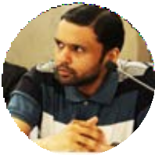
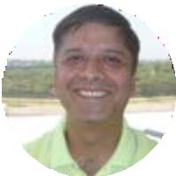



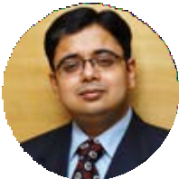
Research Capability
a
Faculty
Joint Faculty
Sumeet Agarwal
(ML, Cognitive Science, Networks) sumeet@iitd.ac.in
Chetan Arora (Computer Vision, ML) chetan@cse.iitd.ac.in
Srikanta Bedathur
(Knowledge Discovery, Data Mining, Natural Language NLP) srikanta@cse.iitd.ac.in
Souvik Chakraborty
(Deep Learning, Digital-Twins) souvik@am.iitd.ac.in
Niladri Chatterjee
(Machine Translation, Reasoning, Statistical Modelling) niladri@maths.iitd.ac.in
Arpan Kumar Kar
(ML applications, Social Media Analytics, Information Management) arpankar@iitd.ac.in
4 Yardi School of Artificial Intelligence

Slide 5
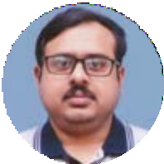
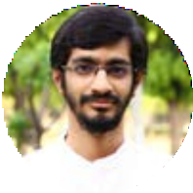
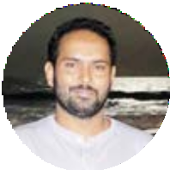
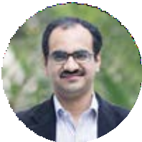

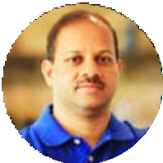
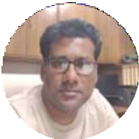
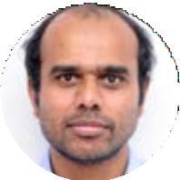
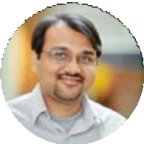
Hariprasad Kodamana
(Anomaly Detection, Optimization) kodamana@iitd.ac.in
N. M. Anoop Krishnan
(Material Modelling, Material Discovery) krishnan@iitd.ac.in
Sandeep Kumar
(Optimization, Graphical Models) ksandeep@iitd.ac.in
Rohan Paul
(Robotics, Embodied AI, Planning) rohan@cse.iitd.ac.in
Sayan Ranu (ML for Graphs, Bioinformatics)
sayanranu@cse.iitd.ac.in
Anurag Rathore (Continuous Processing, Data Analytics, Medical Imaging) arathore@chemical.iitd.ac.in
Sitikantha Roy
(Soft Robotics, Biomechanics, Healthcare, Scientific Machine Learning)
sroy@am.iitd.ac.in
Parag Singla
(ML, Deep Learning, Neuro-Symbolic Analysis) parags@cse.iitd.ac.in
Mausam
(Natural Language Processing, Machine Learning) mausam@cse.iitd.ac.in
IIT Delhi 5

Slide 6
Associate Faculty
Manish Agarwal (Molecular Simulations, HPC)
Zmanish@cc.iitd.ac.in
Nitya Nand Gosvami (Nanoscience, Nanotechnology) Ngosvami@iird.ac.in
Preeti Ranjan Panda (Embedded Systems, Memory Management) Panda@cse.iitd.ac.in
Rohit Vaish (Computational Social Choice, Game Theory) Rvaish@iitd.ac.in
Ankush Agarwal (Econometrics) Ankush@hss.iitd.ac.in
Agam Gupta (Computational Social Science, digital platforms management) Agam@iitd.ac.in
Ishaan Gupta (Bioinformatics, Genomics) Ishaan@iitd.ac.in
Kolin Paul
(Affordable Healthcare, Embedded Systems) Kolin@cse.iitd.ac.in
D. Sundar
(AI for Healthcare and life sciences) sundar@dbeb.iitd.ac.in
Prabhu Babu
(ML, Bioinformatics, Signal Processing) Prabhubabu@care.iitd. ernet.in
Maya Ramanath
(Database Systems, Information Retrieval, Web) Ramanath@cse.iitd.ac.in
Manan Suri
(Hardware Design, Neuromorphic Computing, Edge Computing) Manansuri@ee.iitd.ac.in
Amitabha Bagchi (Algorithms, Data Structures, Networks) Bagchi@cse.iitd.ac.in
M. Ali Haider (ML, Chemistry, Simulation) Haider@iitd.ac.in
Manojkumar Ramteke (Meta-Heuristic Algorithms, ML)
Mcramteke@iitd.ac.in
Adjunct Faculty
Dinesh Garg
IBM
(Algorithms, Data Mining, ML) Garg.dinesh@in.ibm.com
Sorav Bansal (Compilers, Operating Systems) Sbansal@iitd.ac.in
Jayadeva
(ML, Neuromorphic engineering) jayadeva@ee.iitd.ac.in
Manabendra Saharia (Water&Climate, Hydrologic Modeling) Msaharia@iitd.ac.in
Abhijnan Chakraborty (Social computing, Information Retrieval, Ethical AI) Abhijnan@iitd.ac.in
Tarak Karmakar
(ML, Simulation, Molecular Dynamics) Tkarmakar@chemistry.iif. ac.in
Smritu R Sarangi
(ML, Accelerator Design, Low Power Processor Design) Srsarangi@cse.iitd.ac.in
Pradeep Shenoy
Google Research (Cognitive Science, ML)
Pshenoy@cs.washington.edu
Arpan Chattopadhyay (reinforcement learning, multi-armed bandits, online learning, wireless communication, IoT) Arpanc@ee.iitd.ac.in
Lalan Kumar
(Brain Computer Interface, Microphone Arrays) Lkumar@ee.iitd.ac.in
Rijurekha Sen
(Mobile and Embedded Computing, Sustainability) Riju@cse.iitd.ac.in
Prathosh A. P.
Indian Institute of Science (Computer Vision, Audio Analysis) Prathoshap@ee.iitd.ac.in
Amit Mehndiratta (Algorithms, Medical Image Processing, Rehabilitation) Amehndirtatta@cbme@iitd. ac.in
Sandeep Sukumaran (Climate Modeling, Climate Change) Sandeep.sukumaran@cas. iitd.ac.in
Tapan K Gandhi (Neuroscience, ML, Assistive Technology) Tgandhi@iitd.ac.in
Manik Verma Microsoft Research (ML, Computer Vision) Manik@cse.iitd.ac.in
Ashwini Vaidya (Computational Linguistics, Cognitive Science) Avaidya@hss.iitd.ac.in
Gourab Ghatak
(Stochastic Geometry, MM- Wave Communication, 5G) Gourab.ghatak@iitd.ac.in
Aparna Mehra (Optimization Theory) Apmehra@maths.iitd.ac.in
Shaurya Shriyam (Simulation Modelling, Optimization) Shriyam@iitd.ac.in
Anup Singh
(Healthcare, ML, Medical Image Processing) Anupsm@iitd.ac.in
Mani Mehra (Wavelets Methods, Numerical Methods)
Mmehra@maths.iitd.ac.in
6 Yardi School of Artificial Intelligence

Slide 7

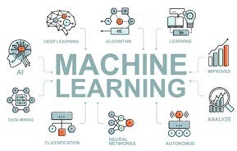
Machine Learning
b Areas
ScAI has a strong presence of researchers working in core machine learning. The research focuses on a number of areas, including neuro-symbolic reasoning, deep generative models, graph neural networks, physics-informed machine learning, and fairness in machine learning.
Key Benefactors
Autonomous systems
Impact areas
Neuro-Symbolic Reasoning: This is an emerging area of Machine Learning / Deep Learning where the goal is to combine the power of low-level perceptual reasoning with logical/symbolic reasoning at a higher level. It has been argued that such a combination is central to taking today’s deep learning systems to the next level. While much has been stated about the combining the power of two paradigms, the research in the community is still at an early stage. At ScAI, we have an active presence in the area, where we have worked on effective methods for solving puzzles (e.g., Sudoku) with solution multiplicity, incorporating location-based constraints for QA, evidence based back propagation in deep learning models, Transfer learning Relational MDPs using Deep Models. We are actively furthering these research directions for transfer learning across domain sizes in structured domains, neuro-symbolic image manipulation, as well as neuro-symbolic robot plan synthesis given natural language commands.
ML Research
Physical systems
Faculty
Sayan Ranu
Sandeep Kumar
Jayadeva
Parag Singla
Arpan Chattopadhyay
Souvik Chakraborty
N. M. Anoop Krishnan
Physics Informed Machine Learning: This is another emerging area that deals with systems having well-defined governing laws (for e.g., fluids, solids, material behavior, biological systems etc.). The goal here is to develop machine learning algorithms that satisfy the physical principles underpinning the behavior of the systems, including non-linear behavior, complex physical interactions etc., enabling robust and generalizable models. ScAI has an active presence in this area and has developed physics- informed neural networks for solving materials modeling, fracture mechanics, and reliability. We are also working on the problem of architecture design – can we design a network architecture that automatically encodes the governing laws for a problem. Other research questions that ScAI is actively pursuing includes
(a) extending physics-informed machine learning to grey-box
IIT Delhi 7
Srikanta Bedathur
Mausam

Slide 8
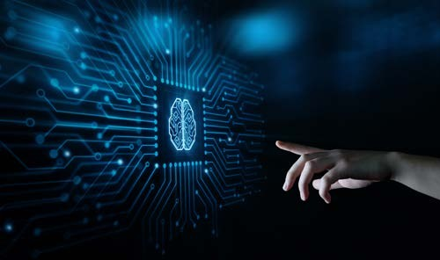
problems (physical laws known in an approximate sense) and (b) developing machine learning algorithms that can discover governing laws from data (suitable for problems where the governing equations are completely unknown).
Deep Generative Models: The goal in these models is to be able to effectively generate data from an underlying distribution implicitly specified in terms of representative samples. Our recent work has characterized the connection between good generation, and size of the latent dimensions for Adversarial Autoencoders. Another recent work proposes a flexible prior for better optimizing the bias-variance trade-off resulting in SoTA generation quality in WAE based models. We are also working on the problem of domain transfer in Generative Models: given a generative model learned over a domain with large amounts of data, how do we transfer the learned model to generate samples from another (similar) domain with limited training data. This problem of domain transfer has gained traction in recent years. We have recently designed a new approach for this problem showing gains over the state-of-the-art models, and the work is currently under review. Finally, we have also worked on the problem of labeled graph generative models that have important applications in drug discovery and anomaly detection. Designing generative models for graphs is challenging since graphs represent a joint distribution of topology and semantics (such as node and edge labels, annotations in the form of temporal time-stamps, constraints such as valencies in molecules, etc.), which we need to learn from the representative samples.
Fairness in Machine Learning: This area focuses on having models which are unbiased with respect to specific attribute classes, e.g., gender or race. Rather having an absolute notion of fairness (i.e., probability of positive class should be equal conditioned on every value of the given attribute), we rather focus on the notion of data driven fairness, where we define fairness in terms of relative percentages of positive class examples for each attribute value in the predicted output and in the training data. Our current work focuses on performing a principled analysis of impact of class skew, class skew given the attribute, and attribute skew on the amount of fairness obtained in the learned model. We are also working on the notion of fairness specifically in the context of ML applied to vision problems and published some exciting work recently on this topic.
8 Yardi School of Artificial Intelligence

Slide 9


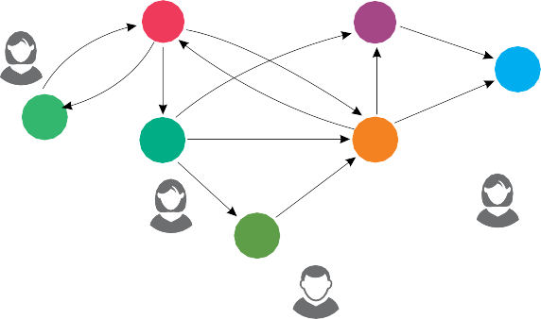
Data Mining
Age ₁₉ Gender Female
Age ₄₃ Gender Male
26
Female
V2
V3
V7
V1
Age ₂₇ Gender Male
Data mining is about using computational methods to retrieve, analyze, and disseminate
Age ₂₅ Gender Female
V4
V5
Age ₃₂ Gender Female
raw data and generate meaningful information. This process can enable government, public and private organizations to generate actionable, valuable data-driven insights. The use of predictive, prescriptive, and causal analysis techniques on massive volumes of data is shown to help in making better decisions, accurate prognosis, and in general, to develop novel strategies that are game changing.
V6
Age ₁₇ Gender Male
Impact areas
Knowledge Bases: While significant advances have been made in utilizing large amounts of textual data available on the Web to automatically construct knowledge-bases, and use them for question-answering tasks, there is a paucity of similar resources for specific domains. For deeply technical domains such as Computer Science, Bio-chemistry, Petro-chemicals, Immunology, and so on, the source of knowledge is not available in textual sources but is scattered across both structured (e.g., organization specific lab-/field-report databases, tables on the Web and technical documents) as well as unstructured (e.g., images, free- flow text, multimodal sources, etc.) sources. Our research aims to rapidly build and maintain structured knowledge-bases through the use of end-to-end configurable data processing pipelines. Our work draws on the group’s deep expertise in NLP, machine learning, and probabilistic database management systems. We have developed solutions for specific domains (e.g., CS and Bio- chemistry), built highly scalable data provenance systems for knowledge-base applications, and are working on configurable systems that can scale.
Key Benefactors
Education
Traffic Management
Social Media Platforms
Recommender systems
Faculty
Amitabha Bagchi
Srikanta Bedathur
Abhijnan Chakraborty
Large-scale Information Streams: Big-data management substrate is a distributed data platform, and a parallel computation framework such as Hadoop or Spark. While these frameworks are already quite scalable, there is an opportunity to further accelerate them using machine learning to optimize their indexing and data placement strategies. Our group has developed adaptive learnt Bloom filters for use in distributed LSM systems (best research paper winner at CODS/COMAD, and papers in KDD’21 and VLDB’22). Going further, in order to support rich semantic queries over multi- modal and highly connected (think social networks) streams of information such as social media to credit card transaction streams, there are several research challenges that our group is working on. We have explored diverse and critical problems such as: efficient management of rapidly changing topical sub networks of network interactions, scalable mining of information flow paths in networked information streams, handling noise and potentially lossy events in information streams, to name a few.
IIT Delhi 9
Maya Ramanath
Sayan Ranu
Arpan Kar

Slide 10







Natural Language Processing
Multilingual Information Systems
Legal Documents
Inclusive Education
Machine Translation Info. Extraction Question Answering Summarization
Understanding human languages has been a cornerstone application of AI, which involves the development of AI models that can understand and evolve with the human languages.
Medical Advice
Dialogue
Dialogue Systems
Key Benefactors
Social Media Platforms
Robots
NLP Group at IIT Delhi focuses on three salient research agendas. First, it builds AI systems that process information expressed in text via information extraction, and share this information to users through question answering and dialog systems. The group is known for its influential work in open information extraction, where information is extracted in an open schema. Second, there is a recent effort in building multilingual systems for various NLP tasks, including information extraction and knowledge base completion. One focus of the group is on processing low-resource languages, such as Indian or African languages. Use of massive multilingual language models, along with parameter-efficient techniques like multilingual adapters offers novel solutions to these problems. Furthermore, the group also uses its technology in the context of various downstream applications such as robotics, healthcare, and materials science.
Materials Scientists
Healthcare
Faculty
Mausam
Parag Singla
Niladri Chatterjee
Ashwini Vaidya
Arpan Kar
Impact areas
Information Extraction: The group has a long history in extracting information from text. This may be done in a domain-specific manner, where a given ontology pre-specifies the type and relation schema. Or, it may be done in a open-domain manner, where the relations and arguments are textual strings extracted directly from text (known as open information extraction). Once, the information is stored in a Knowledge Base (KB), inference enables prediction of novel facts that were unread in text. This KB can downstream be used for answering user queries via question answering.
10 Yardi School of Artificial Intelligence

Slide 11
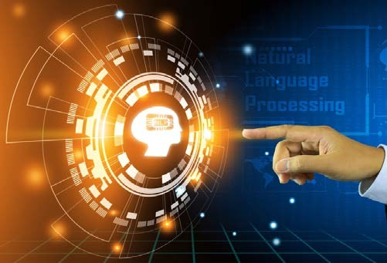
KB-based Dialog Systems: The group has developed a strong focus on building dialog agents that satisfies user’s needs, often querying KBs for information as part of the dialog engine. Often, annotating large dialog data with internal dialog states becomes a bottleneck. The group focuses on training dialog systems with end-to-end training, i.e., using only historical data without any additional annotation.
Multilingual NLP: The group works on studying multilingual systems that can be applied on many languages. It has developed and released multilingual information extraction and knowledge-base completion systems. It has also been studying low resource languages (e.g., Assamese and Bhojpuri) from Celtic, Slavik, African and Indian language families. A particular focus is those languages that are not present in large multilingual models like mBERT. The group has developed novel use of multilingual adapters to extend NLP techniques to such unseen languages.
NLP for Applications: The group is engaged with several application-oriented projects. These include language grounding for vision or robotics, where a user’s natural language command is interpreted by the model and executed by a robot or an image manipulator. It also works with materials scientists to build the world’s largest repository of materials and their properties, extracted from materials science publications. Recently, it has initiated an effort on creating a healthcare bot which can assist physicians in providing medical advice to patients.
Success story
Released Open IE 5 and Open IE 6 softwares that are heavily used by academia and industry and have a collective download count of 16,000+. (Mausam)
IIT Delhi 11

Slide 12

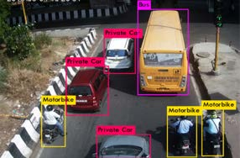
Computer Vision
Computer vision deals with extracting useful information from visual input such as images and videos. Similar to natural vision in human beings, in which eyes capture the visual information and brain interprets them, in computer vision cameras or equivalent devices, capture the scene information and computer interprets them. Computer vision finds its applications in variety of domains ranging from transportation, healthcare, robotics, and consumer devices to security & surveillance, as well as defense
Key Benefactors
Transportation Systems
Healthcare
Smart-city providers Video game
Faculty
Chetan Arora
Jayadeva Rijurekha Sen Manan Suri
The CV group is engaged in developing vision algorithms for diverse scenarios, such as in transportation and healthcare (described earlier). The group also studies fundamental questions in computer vision such as robustness of models and safeguarding them against adversarial attacks, achieving graceful performance for out-of-distribution datapoints.
Impact areas
Working with Small Datasets: Computer vision group is committed to developing visual AI technologies that work for Indian use cases. One of the biggest problems in this is lack of large, annotated datasets. We are working on developing solutions which enable us to build systems with relatively small amount of training data. Active learning allows one to incrementally select the minimal amount of data to annotate, which is best suited for the training an AI system. Our work in this area has been well recognized and allows developing a model with similar accuracy but using only 10% of the annotated data. We are also working on self- supervised approaches by which a model can self-train itself using proxy problems. The group is also working on developing multimodal models such as using image in conjunction with laser range finder, as well as images with ultrasonic sensors to increase the robustness of visual AI models. Another area of interest is domain adaptation which allows one to adapt a model trained on a different data distribution to a new data distribution. For example, using this technique, one an adapt an object detection system trained on European roads, to Indian road conditions with only tiny amount of unlabeled Indian data.
Reliability of Visual AI Systems: Modern machine learning systems are known to be brittle. They work best on the datasets they are trained on but often fail catastrophically and without warning when the data distribution changes. One of our focus areas is to build models that generalize well to different and adverse data
12 Yardi School of Artificial Intelligence

Slide 13
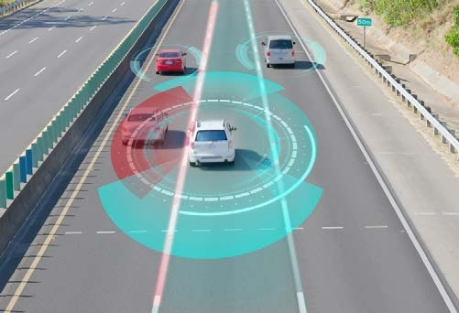
distributions. For example, while there are many solutions available for collision detection in daylight and sunny weather, such systems often fail in rainy, snowy, or hazy conditions or in low light scenario. We have been working on solutions to overcome such constraints. Even after best of such efforts there may still be conditions which are unknown to the developed systems. We are working on techniques which allow a machine learning model to know when it does not know, and hence give control back to the human operator, and not make any decision based on the false premises. The current state of the art solutions are prone to adversarial attacks. In such attacks one inserts a specially crafted imperceptible noise in the system input, which is invisible to human eyes, but causes vision systems to mis-predict. In the past we have developed solutions to prevent such attacks and are currently focused on techniques to mount newer kinds of attacks as well as preventing them.
Wearable and low power camera systems: The group also focusses on wearable cameras. We are one of the leading research groups in analyzing videos from body worn cameras, understanding the activities of the camera wearer, as well as the objects, and the people seen in the camera view. We are known for our algorithms to create 3D maps from wearable cameras as well as the ability to localize a camera wearer within the map. We are exploiting our expertise in the wearable camera domain and are committed to developing a mobility aid for visually impaired people. The system known as MAVI (mobility assistant for visually impaired), is a pocket held device with camera clipped on the shirt. The system warns a visually impaired user about the nearby dogs, and cows which are safety risk in their independent mobility. The system, can also read signboards in Hindi, and English, recognize faces and warn about the impending potholes in the way. In the current form the device can work for up to 3 hours on a single charge. We are working on developing new low energy visual AI models along with the hardware solutions to increase it to 8 hours, as well as to improve the accuracy and applications of the current models.
IIT Delhi 13

Slide 14
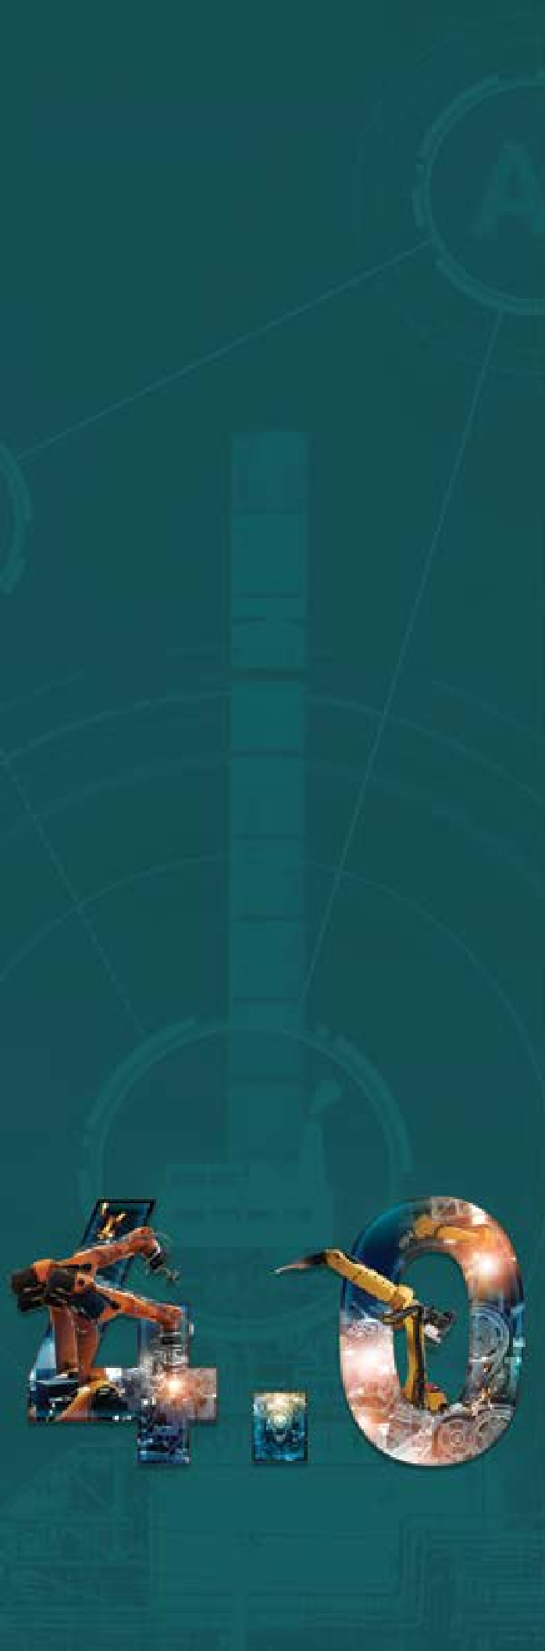
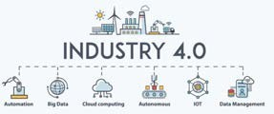
Industry 4.0
The Fourth Industrial Revolution (or Industry 4.0) is the ongoing automation of traditional manufacturing and industrial practices. It majorly involves large-scale machine-to- machine communication and the internet of things (IoT) integrated for increased automation, improved communication and monitoring, and diagnosis without the need for human intervention. India is a country at the cusp of this transition.
Key Benefactors
Oil and Gas corporations
Manufacturing
Faculty
Hariprasad Kodamana
Souvik Chakraborty Shaurya Shriyam Arpan Kar
Arpan Chattopadhyay Manojkumar Ramteke Anurag S. Rathore
The current focus of ScAI in the area of Industry 4.0 is the development of digital-twins, which is a simulated replica of a physical model to perform tests and generate additional new data points. Another focus area is intelligent and sustainable operations for AI-driven decision making for improving efficiency and performance. Finally, to ensure safe operations, the school is also working on building anomaly detection models to detect, diagnose and classify various faults that may occur in a physical infrastructure for targeted and informed remediation and minimize pernicious system downtimes.
Impact areas
Digital twins: As Industry 4.0 picks pace, a key challenge is that of efficient and effective monitoring and control of the process. Digital twins have recently emerged as an effective tool to answer this challenge. We at ScAI, IIT Delhi, are working on developing the first in-silico models for complex continuous processing operations (such as chromatography and ultrafiltration for biopharmaceutical processes). These models involve integration of mechanistic models that capture the undergoing physical processes and machine learning approaches. The digital twins are deployed in real time during manufacturing operations, and if there is a mismatch between the expected and observed variables, alarms and control actions are automatically triggered.
Process monitoring: Our group is doing extensive work on development of machine learning-based soft sensors that can utilize process data to predict product quality attributes using deep neural networks and random forest regression models. Another area of work is to use machine learning tools to detect features, remove noise and increase reliability of data from spectroscopic instruments, which are a novel emerging class of monitoring tools. Finally, the group is working on advanced process-wide supervisory monitoring systems using machine learning for automatic error detection across multiple unit operations simultaneously with hundreds of inputs.
Process control: Next-generation manufacturing process controls in line with Manufacturing 4.0 and Industry 4.0 paradigms are key enablers of quality in manufacturing and can help to increase productivity, lower manufacturing costs, prevent batch failure and improve consistency in product quality. In this area, the group is working on a wide spectrum of machine learning tools using deep neural networks, random forest regression and support vector regression algorithms to automatically detect in-process errors and auto-correct process deviations using an end- to-end automated control system for different industrial processes.
14 Yardi School of Artificial Intelligence

Slide 15

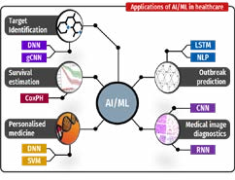
Healthcare
Healthcare is an evergreen sector that has immense scope for integration and application of AI. The goal of healthcare group is to deliver P4 medicine, i.e., predictive, personalized, preventive and participatory. For predictive healthcare, there is significant research activity on novel imaging and diagnostic tools that use AI for predicting diseases and ailments. At ScAI, active collaboration is being pursued with National Cancer Institute, ILBS, AIIMS New Delhi, PGI Chandigarh and other renowned research institutes across the country.
The group specializes in the use of computer vision for processing of radiology data (CT scans, X-rays) to segment organs and tissues, and predicting early onset of diseases such as breast cancer and Celiac disease. Personalized precision medicine aims to analyze individual genome sequences to predict the best treatment, and to build wearable robotic devices for specific patients with impaired movement. Several efforts in new sensing and diagnostic modalities are in advanced stages of fruition. Long standing expertise in VLSI and MEMS is evolving into new kinds of wearables that provide diagnostic data, some even for ambulatory patients. Single cell data analysis forms a key component of the effort in personalized medicine.
Key Benefactors
Hospital Systems
Pharma Labs
Faculty
D. Sundar
Ishaan Gupta
Impact areas
Automated Diagnosis: With the number of doctors, we produce every year, it is extremely difficult, if not impossible, to provide adequate healthcare facilities to the billion plus population of India. This makes it imperative to use automated tools wherever possible which can allow the scarce medical expertise to be available for more urgent needs. Many of the healthcare diagnostics systems involve use of images such as X-Ray, CT- Scan, and MRI. Computer vision group at ScAI is involved with many such problems involving automated diagnosis of various diseases and cancers from the radiological images such as gall bladder cancer detection from ultrasound sonography images, and breast cancer detection from mammograms.
Chetan Arora
Jayadeva
Mausam
Prathosh A. P.
Shaurya Shriyam
Sandeep Kumar
Anurag S. Rathore
Kolin Paul
Sitikantha Roy
Telerobotics: Remotely operated robotics tools allow a doctor sitting in a tertiary health center in a city to offer expert healthcare service in remote and rural areas also. In the current pandemic scenario, the usage has expanded to even the city centers where it is not possible for a doctor to be physically in the same space as patient for the risk of catching infection. The computer vision group is collaborating with Robotics group at IIT Delhi to develop
IIT Delhi 15

Slide 16
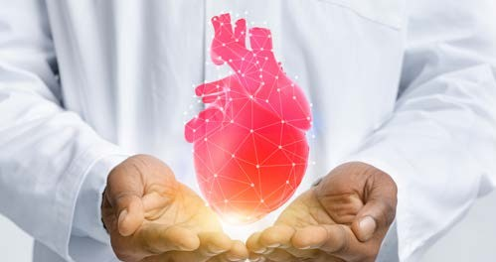
remotely operated ultrasound robotic arm, which will be useful in providing prenatal care in remote centers, as well as covid treatment in a local but physically separated scenarios.
Surgical Simulators: Critical surgeries such of the brain require extreme skills from the surgeons. The current training of the surgeons typically happens on the job under the supervision of an expert teacher, which is both inadequate as well as risky to the patient. Simulators offer an effective alternative allowing trainee surgeons to practice in a variety of settings which are rare to observe in a real surgery. Most importantly, practicing on a simulator does not involve any risk to the patient. The group is involved with developing simulators for skill enhancement, and automated skill evaluation for neurosurgeons.
Efficient surveillance of (g)local public health: Infectious diseases that may cause epidemic/pandemics such as viral infections, diseases caused by antimicrobial resistance microorganisms (AMR), and Tuberculosis, non- communicable diseases that pose the biggest strain on the healthcare system particularly Cancer, Metabolic diseases such as Diabetes and Cardiovascular diseases, and geriatric disorders such as dementia and movement disorders, radio-genomics and personalized medicine—often, for the treatment of a severe cancer, or any other disease, there are multiple treatment modes available to a health practitioner. On the other hand, different patients respond differently to different treatments. One school of thought suggests that this might be induced by the different genetic characteristics of each patient. However, it is often impossible to identify the true genomic makeup of a tumor inaccessible to a biopsy. Faculty groups in ScAI are involved in this important upcoming research area of radiogenomics, which tries to identify various genetic markers based upon the observations through radiological images and other clinical parameters.
Biomechanics: Some active research is going on towards, AI in Sports and human movement biomechanics, cardiovascular disease and neuro biomechanics areas. Groups in ScAI are working on In-sillico modeling and mechanistic understanding of cerebral stroke, aneurism, and other degenerative brain diseases like Alzheimer, and dementia and their subsequent effect on motor activity.
Success story
Developed a model to predict severity and mortality in COVID-19 patients using routine blood parameters in one of the largest cohorts of COVID-19 patients from India. (Ishaan)
16 Yardi School of Artificial Intelligence

Slide 17

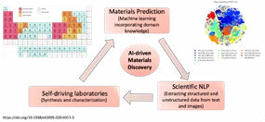
Materials
The progress of human society has been closely linked with the development of materials. This is exemplified by different ages in civilization: the stone age, bronze age, and iron age. Traditional materials design and discovery were based on expert knowledge, intuitions, empirical models, and Edisonian trial-and-error approach. However, this is extremely time consuming and uneconomical. The advent of artificial intelligence, along with large scale computational power and online
databases enable an alternate towards accelerate and tailored discovery.
approach materials
At ScAI, we employ an artificial intelligence (AI)-driven materials discovery paradigm that can accelerate materials discovery and allow knowledge dissemination. The proposed framework is highly multidisciplinary, involving machine learning, materials science, natural language processing, robotics, and other relevant domains. The primary focus will be to provide a platform offering solutions to industry and academia on materials discovery, design, and expert knowledge for various applications such as energy, medical, agricultural, defense, and aerospace sectors, and even materials for AI. Specifically, we work on automated development of databases of materials based on the knowledge from literature. Another area of work is the accelerated simulation of materials by directly learning the interaction laws of individual elements. We also work towards developing tools that enable modeling at multiple scales, both in terms of length and time, to understand the response of materials under different conditions.
Key Benefactors
Metal Manufacturing
Glass Manufacturing
Robotic Design
Faculty
Jayadeva
N. M. Anoop Krishnan
Nitya Nand Gosvami
Impact areas
Materials Discovery
Sayan Ranu
Souvik Chakraborty
Tarak Karmakar
Materials Design
M. Ali Haider
Self-driving laboratories
Mausam
Material Modelling
Success stories
Developed the first materials-aware language model, MatSciBERT, for information extraction and knowledge discovery from materials domain. Downloaded over 50,000 times. (Mausam, N. M. Anoop Krishnan)
Python for Glass Genomics (PyGGi), an AI-based commercial package for discovering novel glass compositions for targeted applications such as smart-phone screens, self-cleaning windows, and fracture resistant windshields. (N. M. Anoop Krishnan)
IIT Delhi 17

Slide 18
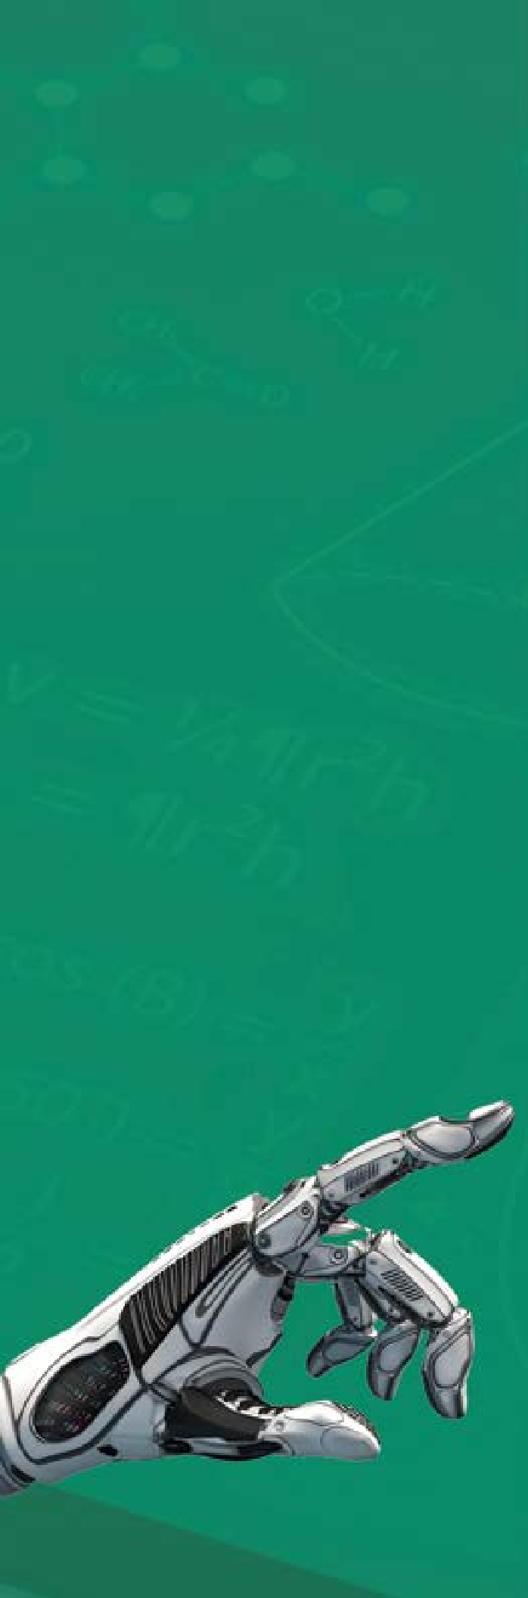
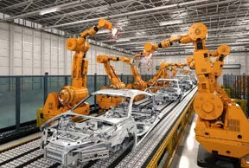
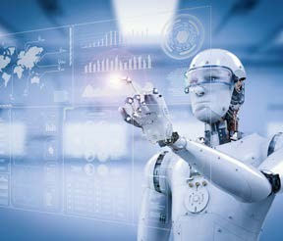
Robotics
Robotics is a key aspect of any physical autonomous system. On one hand, this field is concerned with core principles of AI/ML systems governed by physical laws (e.g., nonlinear systems, physical interactions etc.). This theme is relevant to understand physical phenomena that can have a large impact on our society (e.g., climate, biological interactions etc.). On the other hand, we seek to develop AI/ML models for intelligent robotic systems that can act and interact in the environment (e.g., robot manipulators, soft robotic systems etc.). Here, the challenges lie in the core areas of planning, perception, NLP, reasoning & knowledge, control necessary for physical robotic systems that display general- purpose intelligence, particularly in domains cohabited with people.
The Physical AI group aims to develop AI algorithms such that robotic agents can interact with humans through language, and other commands. The goal is that robots can understand human intent and take necessary steps towards achieving it. This group also studies planning, imitation learning & reinforcement learning approaches so that a robot can piece together a sequence of actions to achieve its goal.
Impact areas
Human-Robot Collaborative Engagements
Key Benefactors
Manufacturing
Assistive Homes
Faculty
Sitikantha Roy
Souvik Chakraborty Shaurya Shriyam Rohan Paul
Arpan Chattopadhyay
Automated Task Management
Planning and exploration
18 Yardi School of Artificial Intelligence

Slide 19



Weather and Climate
Accurate prediction of weather and climate is essential for a wide range of applications, ranging from disaster management to
economic planning. The conventional numerical weather prediction models have inherent predictability limitations. ML has emerged as an invaluable tool in helping society adapt to the effects of climate change. The applications of AI in green economy, climate change, and sustainable
We aim to improve weather and climate predictions on a range of scales, from a few days to multiple seasons, using cutting edge deep learning models. Recent successes include a year-ahead prediction of El Nino Southern Oscillation which is a leading mode of climate variability and the prediction of sea level pressure variability at a lead time of seven days during monsoon. In addition, we also applied deep learning based image processing techniques to detect high impact weather systems, such as tropical cyclones from satellite images. We are also using AI to predict how the artic ice melting affects weather and climate patterns and how such insights can be used to take more informed decisions for energy production and distribution.
development is becoming mainstream. Diminishing glaciers pose a long-time critical risk to water availability and security in India. AI/ML techniques are required for monitoring the nature of glacial changes, estimate their impact, and plan water resource management accordingly.
Key Benefactors
Prediction services
Impact areas
Weather and Climate forecasting
Renewable energy providers
Disaster Management
Sustainable design
Global hydrologic cycle
Faculty
Hariprasad Kodama
Manabendra Saharia Sandeep Sukumaran
IIT Delhi 19

Slide 20

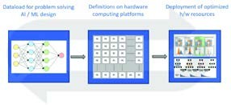
Hardware and Compilers
Hardware and compiler design is essential to improve performance of computational systems as well as develop more informed
systems for niche and applications. Especially, frameworks that employ
mission critical in contemporary edge computing
The embedded systems and compiler group at ScAI aims to leverage AI based methods to improve the efficiency of existing hardware platforms and compilers. For instance, in mobile edge computing environments in-situ processing is critical to minimize service latency, but the processor and battery constraints in legacy systems conflict with heavy computation and low latency requirements. Solving this requires the development of data- driven AI/ML based resource management solutions that can efficiently provision resources and place workloads in distributed computational paradigms. Further, optimizing compilers for trustworthy compilation and minimizing the compilation time to accelerate software development speed are other directions that ScAI focuses on.
infrastructures, being able to deploy AI based workloads on legacy systems is essential to minimize capital expense and minimize the carbon footprint of modern digital transformation. For instance, efficiency design of memory architectures is critical to ensure optimal quality of service. Further,
the conversion of high-level software specification into low-level executable code via a compiler needs to be efficient in terms of the computational requirements and the level of parallelism for best usage of resources.
Key Benefactors
Data and Computational Service Providers
Impact areas
System Design
Hardware Manufacturers
Resource Optimization
VLSDI Design labs
Faculty
Preeti Ranjan Panda
Distributed Computing
Compiler Optimization and Robustness
Kolin Paul Sorav Bansal Rijurekha Sen Manan Suri
Smruti R. Sarangi
20 Yardi School of Artificial Intelligence

Slide 21


Social Media and Security
Social media has increasingly become a key source of insight in a range of fields ranging
from product marketing even health information. co-created by the user
to politics, and The information and the groups
which interact with the user can be in the format of text posts, images and videos. However, social media information analysis by definition requires handling of all 5 ‘V’s of bigdata: volume, velocity, variety, veracity and value. While the information and thus the value within the data is immense, so are the challenges of governing it.
The major on-going research at ScAI related to social media and security include the following. Accurate modeling of information propagation in social media: National and international events of critical interests often trigger mass discussions in social media. These mass topics of discussions could be related to natural disasters like pandemic, events like elections or news surrounding current affairs (say new bill launch). ScAI is keen to develop a series of studies, which can explore information propagation in social networks.
Key Benefactors
Social Media Platforms
Security Firms
Impact areas
Large-scale data management
Faculty
Arpan Kumar Kar
Misinformation Detection
Information Moderation
Srikanta Bedathur
Violating Content Detection
Maya Ramanath
Parag Singla
Success story
Implemented the project models for developing financial products based on forecasting of capital and labour inflow in select European markets / industries and their performance, using predictors of migration, ESG investments and Labour migrating to destination country. (Arpan Kar)
IIT Delhi 21

Slide 22



Cybersecurity
It is critical to defend our information infrastructure from external threats caused due to software bugs and vulnerabilities. Conversely, it is important to build penetration technologies to try and identify bugs and software bugs in adversarial software. Both these areas of work fall under the umbrella
of cybersecurity. Yardi ScAI leverages AI algorithms in tandem with recent advances in formal verification tools to automatically generate proofs of software correctness (defence) and automatically identify bugs in existing software (attack). Our work in these areas has been published at top-tier CS conferences. Entrepreneurial efforts based on this work are also ongoing, in collaboration with Indian defence services.
Impact areas
Security
Key Benefactors
Automobile Industry
Reliability
Energy Industry
Defence
Railways
Aerospace and Defence
Faculty
Sorav Bansal
Smruti R. Sarangi
Kolin Paul
Rijurekha Sen
22 Yardi School of Artificial Intelligence

Slide 23

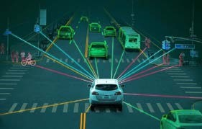
Transportation
Transportation is a major infrastructure that enables the movement of goods and people from one part of the country to another. Due to the heterogenous traffic conditions on Indian roads, ranging from rickshaws to high-speed cars, efficiency and swiftness of transportation is significantly affected. This, in turn, directly impacts the GDP of the country as the number of hours spent on traffic per person effectively translates to the reduction in the number of working hours. In addition, increased traffic contributes to pollution and fuel consumption.
The transportation group at IIT Delhi focus on the use of AI and ML to tackle some of these challenges as follows. The first major area is self-driving vehicles. Even without full autonomy use of computer vision to provide lane departure warning, lane change assistance, collision alert, pothole detection, and pedestrian or stray animal detection on the road can help save thousands of lives every year. While many of such advanced driving assistance systems are already in use in the western world, unstructured environments, and unmaintained infrastructure on the Indian roads pose a much more challenging environment for such systems. The group is also involved with developing such smart signals driven through the cameras installed at the intersections. Other applications the group is working at includes, vehicle license plate recognition, and automated vehicle speed estimation from cameras installed on the roads.
Key Benefactors
Automotive Companies
Transportations Sytems
Faculty
Chetan Arora
Rijurekha Sen
Parag Singla
Impact areas
Transport Anomaly Detection Assistive Driving
Traffic Management
Success story
First work on studying the problem of equitable wages for food- delivery agents and develop solutions. (Sayan Ranu)
IIT Delhi 23

Slide 24

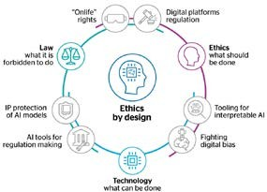
Ethical AI
With increasing adoption of Artificial Intelligence (AI) in domains with high societal importance, such as banking, healthcare, education and hiring, it is important to ensure that the AI applications are designed to be not only lawful, but also ethical. Since most of the AI algorithms are trained on past decisions reflective of historical patterns of human judgment and control, any potential vulnerability of our existing regulatory and societal structures will manifest in the algorithmic decisions, and thus they will be subject to inherent biases and discrimination. Most importantly, an AI system can perform poorly for some groups even when it appears to perform well for everyone on average.
Key Benefactors
Social Media Platforms Legal Systems
Faculty
Abhijnan Chakraborty
Chetan Arora Arpan Kumar Kar
In instances like facial recognition, to address unfairness concerns, ScAI aims to train learning algorithms on more representative data sets. Similarly, in natural language processing tasks, ScAI is developing text and speech data from as many languages as possible to make the systems universally accessible. Likewise, social media related tasks such as search and recommendations require large amounts of dynamic information. Same is true for algorithms ensuring fair treatments to different stakeholders in ecommerce platforms.
Impact areas
Fairness
Information Retrieval
Inclusive Decision Making
24 Yardi School of Artificial Intelligence

Slide 25

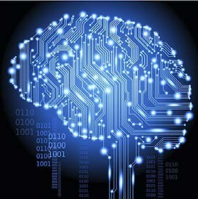
Cognitive Science
Cognitive science is the interdisciplinary, scientific study of the mind and its processes with input from linguistics, psychology, neuroscience, philosophy, computer science/ artificial intelligence, and anthropology. It examines the nature, the tasks, and the functions of cognition, using AI/ML for large impact on the society.
Key Benefactors
Healthcare
Assistive Technologies Inclusive Education
Faculty
Sumeet Agarwal
The cognitive science group focuses on three activities: language cognition which is the use of AI techniques to study how humans understand and produce language, neuroscience that concerns the use of AI and ML over brain fMRI to understand human brain and behavior, and using AI for decision making specifically in the case of modeling choices made by humans, such as their weighing of risk and reward, etc.
Ashwini Vaidya
Pradeep Shenoy
Manan Suri
Impact areas
Language understanding Action recognition Decision Making
IIT Delhi 25

Slide 26








c
Research Infrastructure
To strengthen AI research at IIT Delhi and in the country, ScAI is in the process of housing a 250 AI petaflop high performance AI compute cluster (HAC). The compute nodes for such a cluster would be primarily GPU accelerated nodes with:
50 DGX
A100 node cluster
Each node with 8 GPUs with a combined
performance of
5 AI petaflops
Each node with 10 PB storage capacity
High speed and redundant infiniband network
We thank Anant Yardi and National Supercomputing Mission for their support.
26 Yardi School of Artificial Intelligence

Slide 27




Course Programs
Masters
PhD
ScAI offers the MTech programme in Machine Intelligence and Data Science (MINDS).
MTech in MINDS is designed as an industry-sponsored programme. The students will work on industry-relevant AI problems, since they will be co-advised by an IIT Delhi faculty member and a researcher from the sponsoring company. The MINDS curriculum include graduate-level courses in core AI technologies like deep learning and data science, application-oriented courses like computer vision and natural language processing, and also fundamental courses on mathematics underlying modern AI technologies. The students who join the MINDS program have to complete a set of core courses, bridge core courses, program electives, and a project. These courses could be from course buckets such as mathematics, learning, data science, and applications.
For more details and joining process visit: https://scai.iitd.ac.in/join/mtech
Yardi ScAI welcomes applications from strongly motivated students who want to pursue their Ph.D. in the areas of both core AI and applied AI. Please check our research and faculty pages for understanding various ongoing research at ScAI.
All engineering students irrespective of their Bachelors/Masters discipline are welcome to join a Ph.D. in ScAI. For more information, please refer to the 2021- 22 Semester 1 shortlisting criteria. The criteria may change semester to semester, but gives a broad idea of expectations.
For more details and
joining process visit: https://scai.iitd.ac.in/ join/phd
Join Us
PostDocs
Faculty
Yardi ScAI invites postdocs applications in all areas of artificial intelligence, where AI is interpreted broadly to include all of traditional AI, machine learning and data science. Subareas include the research themes discussed previously.
Yardi ScAI strongly encourages applicants with demonstrated track- record of working at the intersection of an application area and the AI fields.
Yardi ScAI post-doctoral fellows may have done a PhD in any relevant area such as computer science, electrical engineering or mathematics, or also any application area such as civil engineering, electrical engineering, mechanical engineering, management or medicine. Irrespective of the specific area of PhD, the candidate must have performed high quality research in their area, and must have decent exposure to AI techniques.
For more details and joining process visit: https://scai.iitd.ac.in/join/postdocs
Yardi ScAI strongly encourages applicants with demonstrated track-record of working at the intersection of an application area and the AI fields.
If you are interested in applying to Yardi ScAI but have specific questions about life at IITD, work-life balance in India, opportunities for growth/success at Yardi ScAI, please feel free to reach out the head of ScAI at hodscai@admin.iitd.ac.in
For more details and joining process visit: https://scai.iitd.ac.in/join/faculty
IIT Delhi 27

Slide 28
Awards & Recognitions
Mausam: ACL Test of time awards, 2022
Mausam: Listed in Elsevier and Stanford’s list of Top 2% researchers in 2022.
Mausam: Ranked the 56th most influential NLP scholar and 64th most influential AI scholar by ArnetMiner AI2000 Ranking of 2021.
Arpan Kar: Recipient of the Clarivate India Research Excellence Citation Award 2021 based on highest individual citations from 2015-2020
Arpan Kar: Listed in Elsevier and Stanford’s list of Top 2% researchers in 2022 in both single year- based impact and also based on overall career impact.
Arpan Kar: Best Research Paper Award in the ACM ICEGOV 2021 conference in October 2021 in Athens, Greece.
Souvik Chakraborty: Indian National Academy of Engineering (INAE) Young Engineer Award 2022
Souvik Chakraborty: Listed in Elsevier and Stanford’s list of Top 2% researchers in 2022 (single year-based impact).
Abhijnan Chakraborty: Indian National Academy of Engineering (INAE) Young Engineer Award 2022
N. M. Anoop Krishnan: W. A. Weyl International Glass Science Award, 2022 (First Indian to win this award).
N. M. Anoop Krishnan: Indian Academy Sciences Young Associate, 2022
N. M. Anoop Krishnan: National Academy Sciences India Young Scientist Platinum Jubilee Award, 2021
N. M. Anoop Krishnan: Young Scientist Award (Board of research in nuclear sciences, India)
N. M. Anoop Krishnan: Indian National Academy of Engineering Young Engineer Award, 2020
Manan Suri: Indian National Academy of Engineering (INAE) Young Engineer Award 2021
Manan Suri: IASc Young Associate, 2020
Manan Suri: IEEE Young Technologist of the year Award - 2021
Sayan Ranu: Distinguished Reviewer Award at VLDB 2022
Sayan Ranu: Outstanding Reviewer Award at WSDM 2021
Sayan Ranu: IASc Young Associate, 2020.
21. Anurag Rathore: Listed in Elsevier and Stanford’s list of Top 2% researchers in 2022.
Preeti Ranjan Panda: Listed in Elsevier and Stanford’s list of Top 2% researchers in 2022.
Jayadeva: Listed in Elsevier and Stanford’s list of Top 2% researchers in 2022.
Jayadeva: Fellow of the INAE, 2020.
Jayadeva: IETE Ram Lal Wadhwa Award, 2021.
Srikanta Bedathur: ECIR Test of Time Award, 2020.
Srikanta Bedathur: Best Paper award in CODS- COMAD 2020.
Rohan Paul: First India-based Area Chair for Conference on Robot Learning (CoRL) 2022.
D. Sundar: Appointed as a Member of the Task Force on ‘Theoretical and Computational Biology (Bioinformatics, AI and Big Data)’ of the Department of Biotechnology (DBT), Govt of India (2022-2025).
D. Sundar: Appointed as a Member of the CII National Task Force on Science and Data (Genomics), 2021.
28 Yardi School of Artificial Intelligence

Slide 29

AI related Sponsored Projects (Industry)
IBM – IITD AI Horizons Network – Neuro-Symbolic Information Systems (IBM)
Solving Problems of Network Operations (Nokia).
Social-Aware Recommendation for E-commerce
2.0 (Flipkart).
Adaptive Credit Policy - Application of Reinforcement learning in Order and Credit Management (BASF).
Machine learning based algorithm development for Cardiovascular Biomechanics (Dozee Health Inc.).
Algorithms and Architectures for Machine Learning and Computing on the Edge (Cadence Design Systems Inc.).
Extreme Classification (Microsoft Research India).
Exploring Migration and its Impacts in Europe (Fidelity International).
Algorithmic aspects of driver unbundling for food delivery (Jubilant Foods Ltd.).
Scalable Spatio-temporal Measurement and Analysis of Air Pollution Data for Delhi-NCR using Vehicle Mounted Sensors (IMPRINT)
Data Driven Techniques for Fault and Horizon Identification in Oil Reservoirs using 3-D Seismic Datasets (Schlumberger)
Optimal Allocation of Drivers for the Food Delivery Problem (Swiggy).
Social Media Analytics for Security (NSCS, GoI)
Development of Cognitive Model for an Intelligent Robotic Teammate (DRDO)
Adaptive Assistive Devices (Phoenix Medical Systems Pvt. Ltd.).
Deep learning methodologies to develop novel pre- or early cancer detection technology for patients diagnosed with pancreatic cancer (Henry Ford Health System).
Tractable Probabilistic Logic Models: A New Deep Explainable Representation (DARPA).
Unified Multimodal Index in Virtualized Data Platforms (Huawei).
Studying End-End Modeling of Symbolic Components in Neural Architectures for Mixed- Mode Tasks (Google).
Language Models for Multimodal Humorous Texts (Microsoft).
Machine Learning for Financial Data (Fidelity International).
Multi Language SPO Extraction for KG Research (Huawei).
Deep Learning for Knowledge Graph based Question Answering (Tata Consultancy Services).
Information Extraction in Recruitment (InfoEdge)
Used Vehicle Price Prediction (Shriram Automall India Ltd.)
Automatic Creation of Domain-specific Knowledge Graphs (Verisk Analytics).
Development of digital twins NVIDIA.
Machine Learning for fatigue modelling (Siemens).
Digital twins for personalized treatment (OHSL).
Predicting drivers’ performance in a racing simulator (Racing Unleashed).
Designing glasses for nuclear waste immobilization (BARC).
AI-based discovery of glass compositions for space applications (ISRO).
AI-driven optimization of cement production (Innovandi).
Exploration of Spiking Neuromorphic Networks (TCS Research and Innovation).
IIT Delhi 29

Slide 30
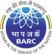















30 Yardi School of Artificial Intelligence

Slide 31
Academic Collaborators
AIIMS, India
Alborg University, Denmark.
Allen Institute of AI, USA.
Carnegie Mellon University, USA.
Colorado State University, USA
Delft University of Technology, Netherlands
Hebrew University of Jerusalem, Israel.
IIIT Hyderabad
IIT Bombay
Korea Advanced Institute of Science & Technology, South Korea.
McGill University MILA, Canada.
Missouri Institiute of Science and Technology, USA
Nanyang Technological University (Singapore)
Neoma Business School, France
Northwestern University (USA)
Ohio State University, USA.
Politecnico Di Milano, Italy.
SciLife Labs, Karolinska Institute, Sweden
South Denmark University, Denmark
Swansea University, UK
University of Bradford, UK
University of British Columbia, Canada
University of California, Los Angeles, USA.
University of California, Santa Barbara (USA)
University of Glasgow, UK.
University of Illinois at Urbana Champaign, USA.
University of Illinois, Chicago (USA)
University of Jena, Germany,
University of Manchester, UK
University of Queensland, UK
University of Sao Paulo, Brazil.
University of Talinn, Estonia
University of Texas, Dallas, USA.
University of Wellington, New Zealand.
University of Western Australia
IIT Guwahati
IIT Kanpur
IIT Madras
Imperial College London, UK.
Indian Institute of Science - Bangalore
King Abdul Aziz University, Saudi Arabia
AI related startups
affiliated with IIT Delhi
Botlab Dynamics Pvt. Ltd., Design & development of drones for deployment in veritable real- life. and scientific applications in the areas such as but not limited to agriculture, defence and payload delivery tasks.
Matisoft Cyber Security Labs Pvt Ltd, Intelligent security software.
CYRAN AI Solutions Pvt Ltd, Nanoelectronic hardware based computing and cyber physical security solutions.
MOVTRACK BIOMEDICAL PVT LTD, AI-enabled clothing to re-
invent the exercise experience of physiotherapy/rehabilitation patients and gym-goers.
Aerogram Private Ltd, Creation of a network of air pollution- monitoring devices to get hyperlocal data and enable data driven decision making.
AiNS Peopletech, AI-ML based Skill-matching and skill development.
Growdea, AI ML applications for computational drug design.
1mg Technologies Pvt Ltd, Task Oriented Dialog Systems for Medical Domain.
9. Cognius.ai, Building the Next- Generation Task-Oriented Dialog Systems.
KnowDis.ai, Knowledge Graph Embeddings & Recommender Systems.
Avishkaar, Inculcating Creativity in Children through Robotic Designs.
I2e1.com, Digital Inclusion through Information to Everyone.
Deeppro Pvt. Ltd., Improving process intensification using AI.
Substantial AI Pvt. Ltd., AI- driven materials discovery.
IIT Delhi 31

Slide 32
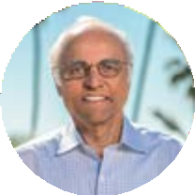
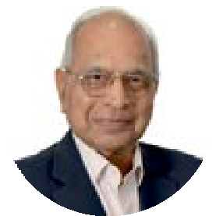
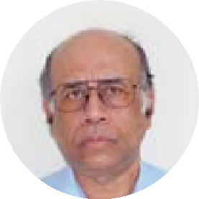

Donors
Anant Yardi
Arun Duggal
Amiya Basu
Google
Contact
AD 236, Main Building, Indian Institute of Technology Delhi
Hauz Khas, New Delhi, 110016, India
+91-11-2654-8728 (O)ofﬁce@scai.iitd.ac.in
cygnusadvertising.in

